Slide 1
Git for Open Source
Software Development Team Session 2

Slide 2


Audience Q&A Session
ⓘ Start presenting to display the audience questions on this slide.
Notes:
📣 This is Slido interaction slide, please don't delete it. ✅ Click on 'Present with Slido' and the questions from your audience will appear when you get to this slide.

Slide 3
Agenda
Good first issues
Assignment
Fork
Switch to repo
Branch
Work
Commit
Push
PR
Other commands
Hacktoberfest

Slide 4
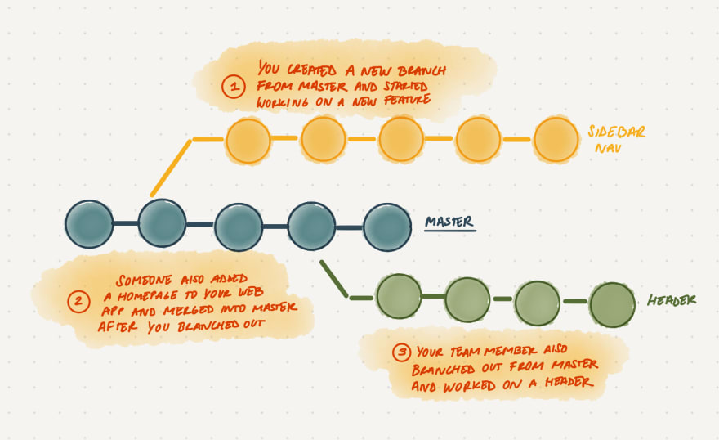

Slide 5
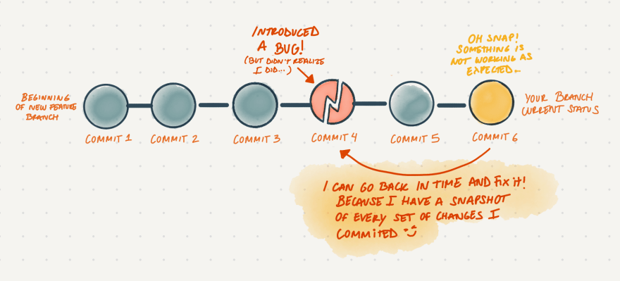

Slide 6
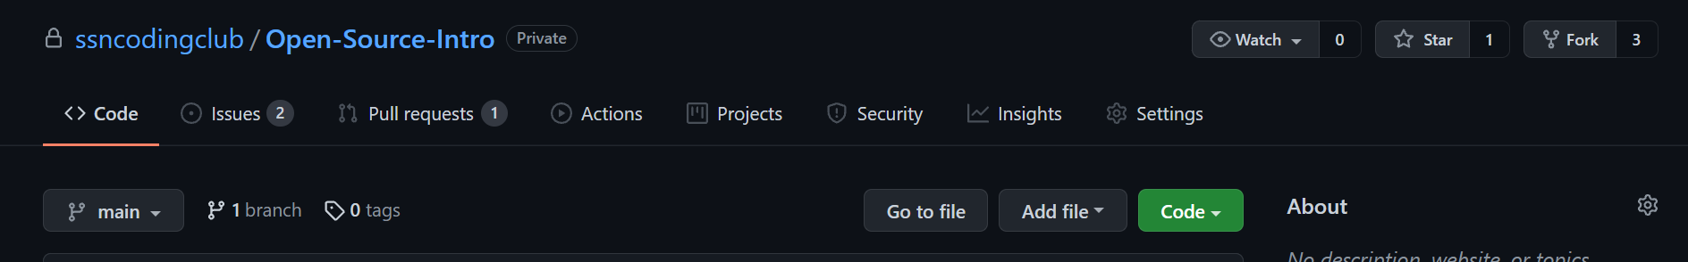
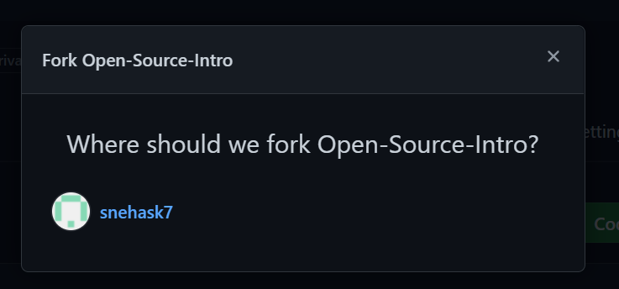
Forking

Slide 7
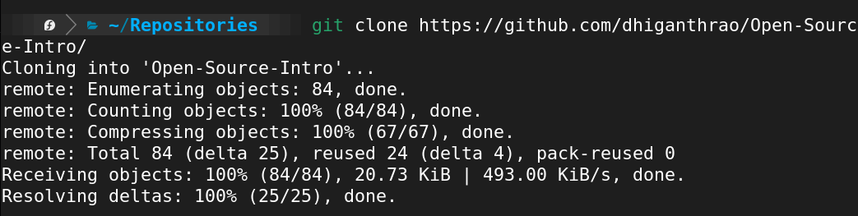
Cloning

Slide 8
Branching

Slide 9
Do your work!

Slide 10
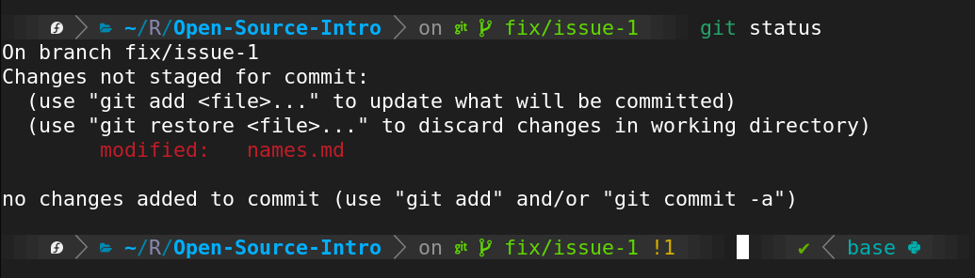
Check your status

Slide 11
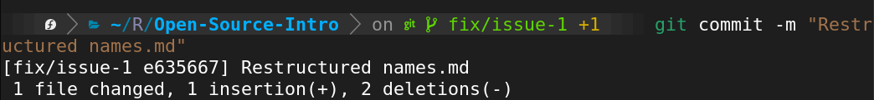
Add and commit

Slide 12
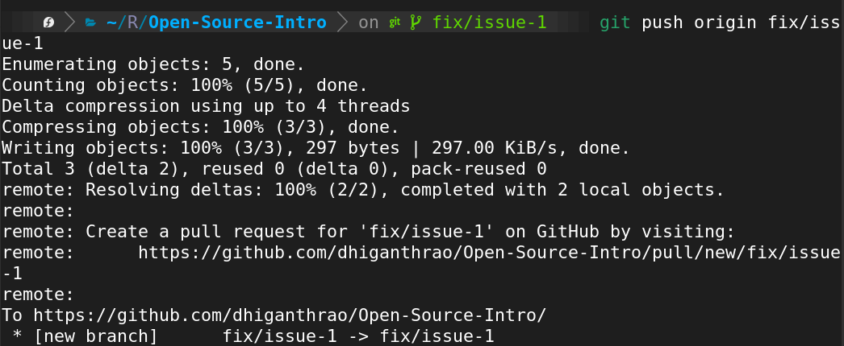
Push

Slide 13
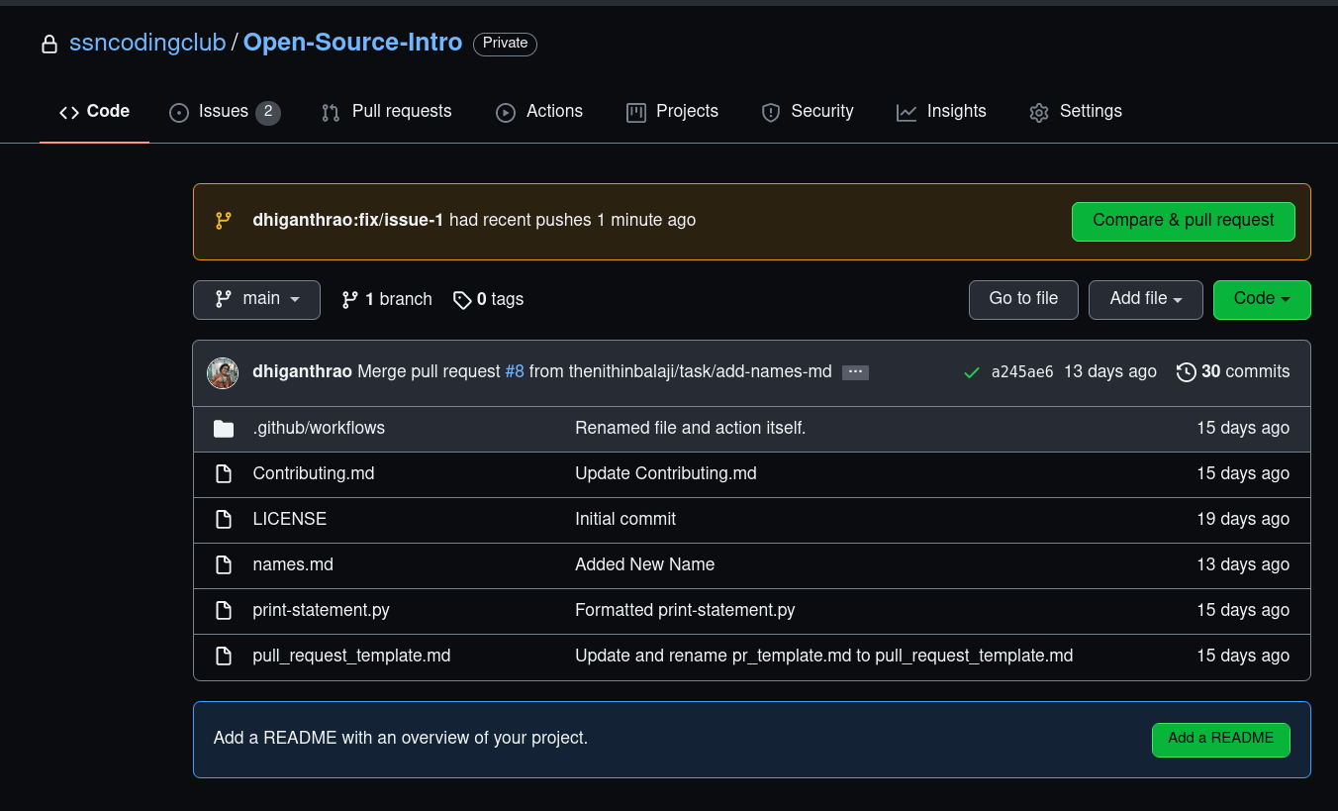
Pull Request

Slide 14
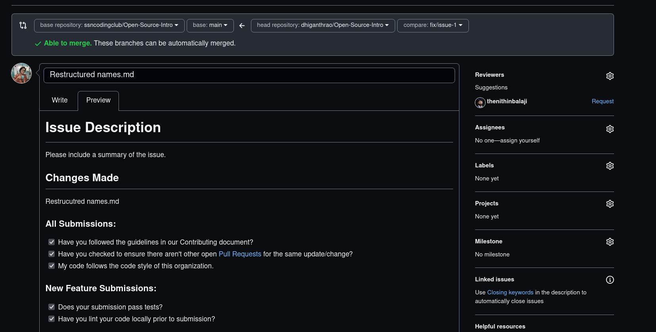
Check for Conflicts

Slide 15
Other commands
Log - https://www.javatpoint.com/git-log
Merge - https://www.atlassian.com/git/tutorials/using-branches/git-merge
Rebase - https://www.atlassian.com/git/tutorials/rewriting-history/git-rebase
Squash - https://stackoverflow.com/questions/35703556/what-does-it-mean-to-squash-commits-in-git
Pull - https://www.freecodecamp.org/news/git-pull-explained/
Upstream vs Origin - https://stackoverflow.com/questions/9257533/what-is-the-difference-between-origin-and-upstream-on-github

Slide 16
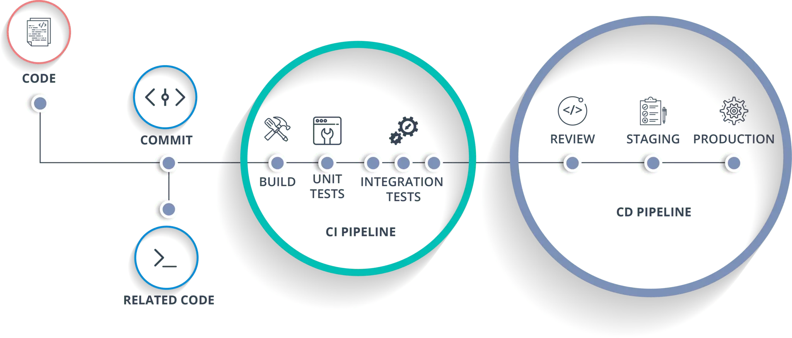
General Open-Source Pipeline (used in companies as well)

Slide 17

https://github.com/vinitshahdeo/Hacktoberfest2021
https://github.com/Sushreesatarupa/DSA-cpp-Hacktoberfest2021
https://github.com/abhpd/hacktoberfest2021

Slide 18
Resources
https://www.youtube.com/watch?v=RGOj5yH7evk
https://lab.github.com/
https://www.atlassian.com/git/tutorials/atlassian-git-cheatsheet
https://www.dataschool.io/how-to-contribute-on-github/
https://stackoverflow.com/questions/35942754/how-can-i-save-username-and-password-in-git

